Slide 1
Hack the Future: A Gen AI Sprint Powered by Data

Slide 2



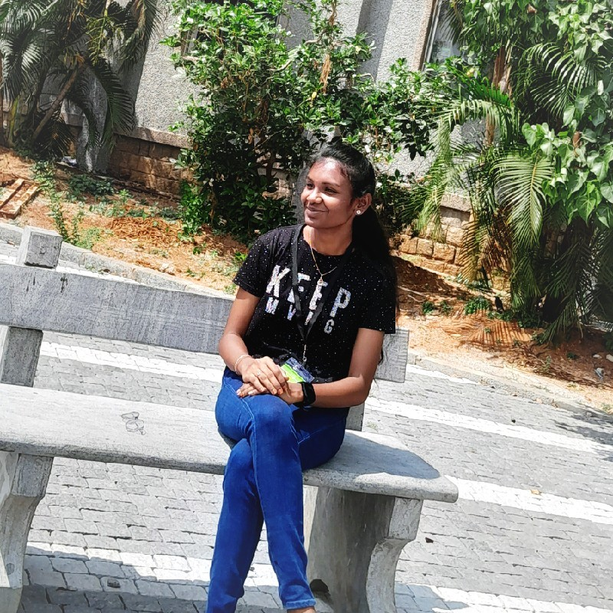
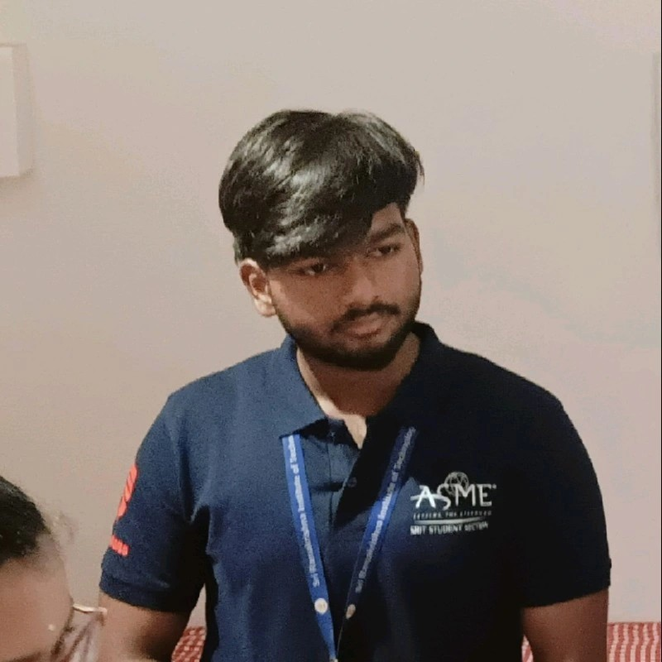
Hack the Future: A Gen AI Sprint Powered by Data
Data and AI Week
Team details
TEAM NAME:Hash-It-Out
Kaviya B (Team Leader)
Loga Dharinish V
Photo

Slide 3
Entry Submission Summary
Idea Title | PersonaPick – Personalized AI-Powered Shopping Recommendations
Team Name | HASH IT OUT
Problem Statement | Online shoppers often face decision fatigue due to an overwhelming number of product options. Traditional recommendation systems lack personalization based on a user's real-time behavior, preferences, and seasonal trends.
Proposed Solution | PersonaPick is an intelligent recommendation system that personalizes product suggestions based on customer demographics, browsing and purchase history, seasonality, and sentiment analysis. By analyzing two datasets—customer behavior and product attributes—the system delivers smart, context-aware, and probability-ranked product recommendations that enhance user experience and drive conversions.

Slide 4



Problem Statement (in detail)
Current e-commerce systems rely on manual customer segmentation and static rule-based methods, making personalization inefficient and time-consuming.
Recommendations often fail to consider real-time user behavior, seasonality, and emotional context, resulting in irrelevant product suggestions.
Generic recommendations lead to lower user satisfaction, poor engagement, decreased customer retention, and reduced conversion rates.

Slide 5
Proposed Solution Overview
Brief approach description or methodology used to tackle the problem
We propose a Personalized Product Recommendation Engine that uses machine learning and data analytics to deliver accurate, context-aware suggestions tailored to individual customer preferences.
KEY METHODOLOGY
Data Integration:
Merged customer behaviour & product datasets for a unified view.
Feature Engineering:
Extracted key features like segment, season, sentiment score.
Model Development:
Built predictive ML models (e.g., Random Forest, XGBoost).
Recommendation Engine:
Generated ranked product lists per user profile.
Evaluation:
Tuned models using precision, recall & F1-score for performance.
Outcome: Improves user engagement and boosts sales through smarter, personalized recommendations.

Slide 6
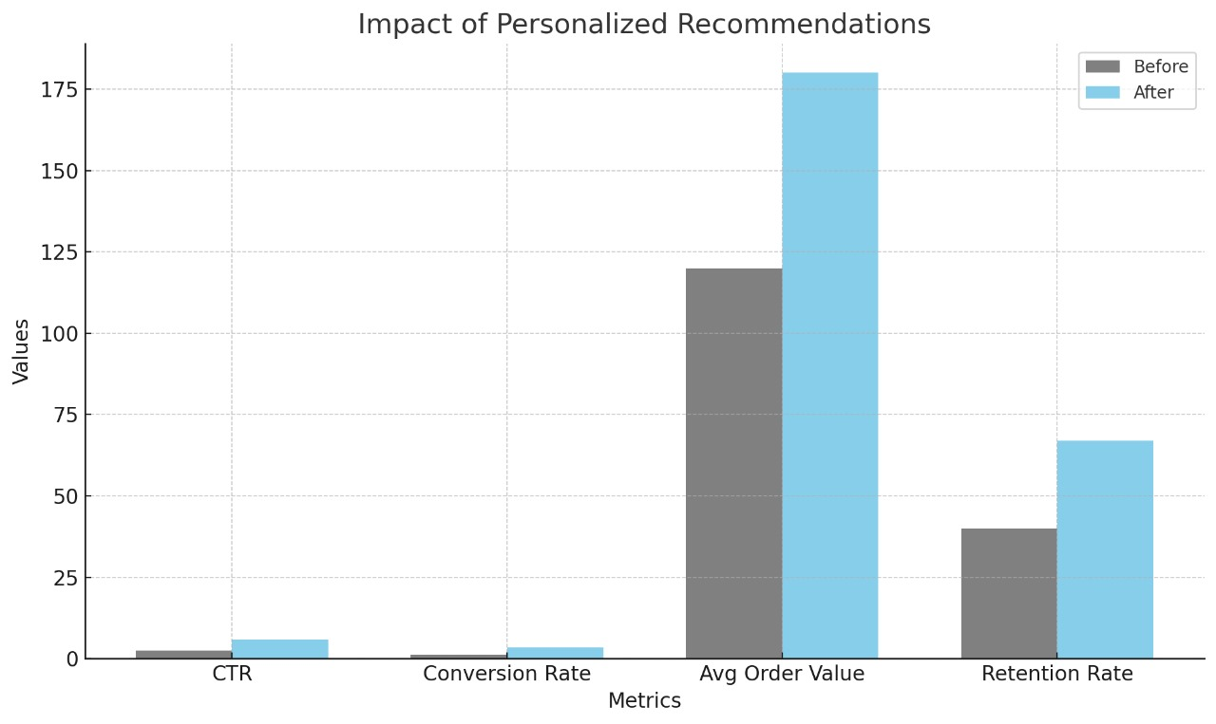
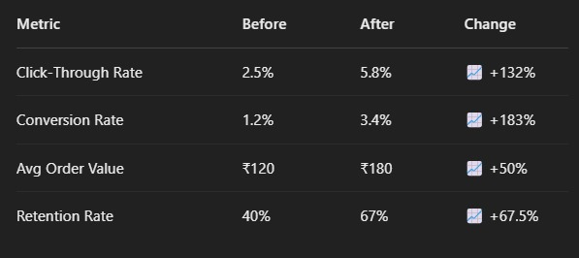
🔧 Programming & Scripting:
Python (for data preprocessing, model building, and evaluation).
Pandas, NumPy (data manipulation).
📊 Data Visualization:
Matplotlib, Seaborn (visual analysis & insights)
🧠 Machine Learning:
Scikit-learn (model training and evaluation)
XGBoost / Random Forest (predictive modelling)
🗂️ Data Handling:
CSV files (customer & product datasets)
JSON (for product list and purchase history)
🌐 Tools & Platforms:
Jupyter Notebook / Google Colab (development environment)
GitHub (version control & collaboration)
🧪 Evaluation Metrics:
Accuracy, Precision, Recall, F1-Score.
Technologies Used

Slide 7






Agents' interaction design
Customer Agent
Inputs preferences, browsing & purchase history.
Interacts via web/app interface.
Recommendation Engine Agent
Analyses user profile and behavioural data.
Matches products using collaborative filtering and content-based filtering.
Product Knowledge Agent
Maintains product features, ratings, sentiment scores.
Supplies relevant product options to Recommendation Engine
Data Processing Agent
Handles preprocessing, feature engineering, and updating user-product matrices.
Triggers model retraining based on new data.
Feedback Agent
Collects user ratings & feedback on recommended products.
Feeds insights back to improve personalization.

Slide 8
Code structure
📁 Data Preprocessing • data_cleaning.py – Handles missing values, type conversions • feature_engineering.py – Extracts and transforms key user/product features 📁 Recommendation Engine • content_based.py – Matches products based on user preferences • collaborative_filtering.py – Suggests products using similar user behaviour • hybrid_model.py – Combines both methods for improved accuracy 📁 Model Evaluation • metrics.py – Calculates accuracy, precision, recall • validation.py – Cross-validates recommendation results 📁 Interface & Interaction • app.py – Connects backend logic to user interface • agents_interaction.py – Manages communication between components 📁 Utils & Configs • config.yaml – Stores model parameters and runtime settings • helpers.py – Utility functions for logging, formatting

Slide 9
Conclusion
Our personalized product recommendation system offers a user-centric approach to enhance e-commerce experiences by leveraging customer profiles, behavior, and contextual data.
By integrating advanced data analysis and recommendation algorithms, we deliver accurate and relevant product suggestions that improve user satisfaction and engagement.
This solution directly addresses the problem of information overload in e-commerce platforms by simplifying product discovery and tailoring offerings to individual preferences.
Ultimately, it boosts conversion rates and strengthens customer retention through smarter, data-driven personalization.

Slide 10
References/Other details
Datasets Used:
1) Customer Dataset: Simulated e-commerce user data (Age, Gender, Purchase History, etc.)
2)Product Dataset: Product metadata with ratings, categories, sentiment scores, etc.
Tools & Technologies:
1)Python (Pandas, NumPy, Scikit-learn, Seaborn, Matplotlib)
2)Jupyter Notebook for development and analysis VS Code for implementation Excel / Google Sheets for initial data formatting.
Key References:
Research papers on recommendation systems (IEEE, Springer)Online articles on e-commerce personalization strategies Documentation for Python libraries used.

Slide 11

Thank You

